Slide 1

Approximating Discrete Closed Curves using Cubic Curves
Samantha Tomeï and Dr. J.B. Hood
Midwestern State University
July 2nd, 2010

Slide 2
Overview
Introduction
What are discrete closed curves?
Why use cubic curves?
Past research in this area – UGROW 2008
Week 1
Code, code, and some more code
Frequency approach
Week 2
Standard deviation and mean
Patterns

Slide 3
Overview cont.
Week 3
Coding EUREKA! Non-optimized solution
Manipulating parameters
Week 4
Final product
Acknowledgements

Slide 4
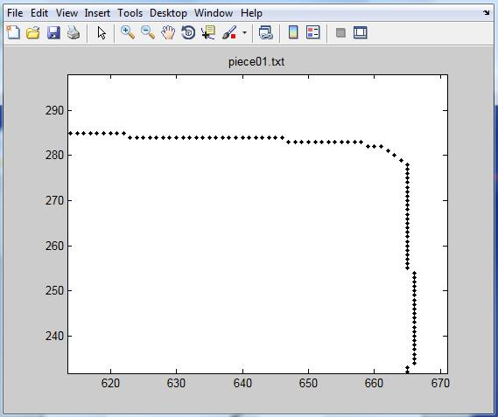
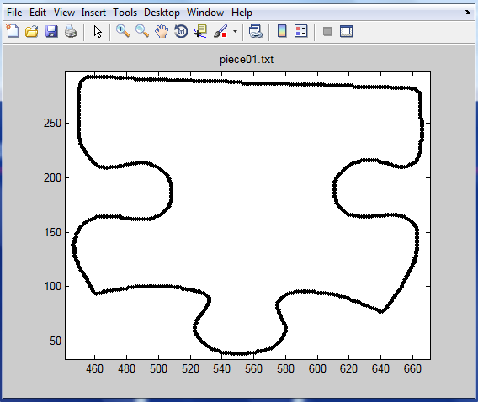
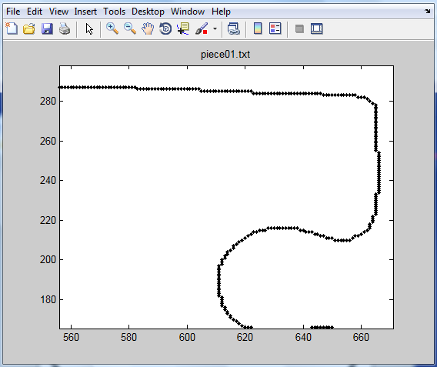

Discrete Curves
Our puzzle pieces have between 800 and 1500 data points
This is a lot of data to process and can slow down the software used to reconstruct the puzzle
So how can we fix this?
Continuous Puzzle Piece

Slide 5
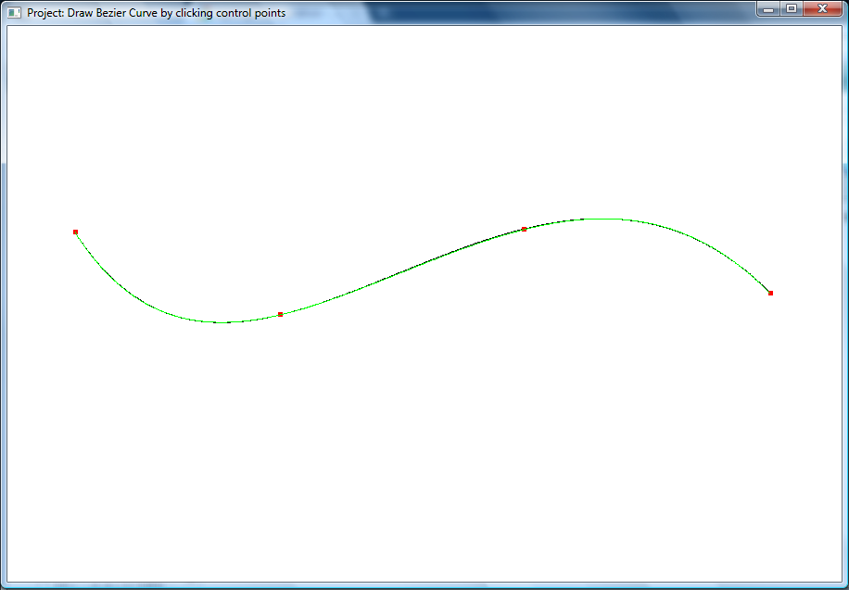
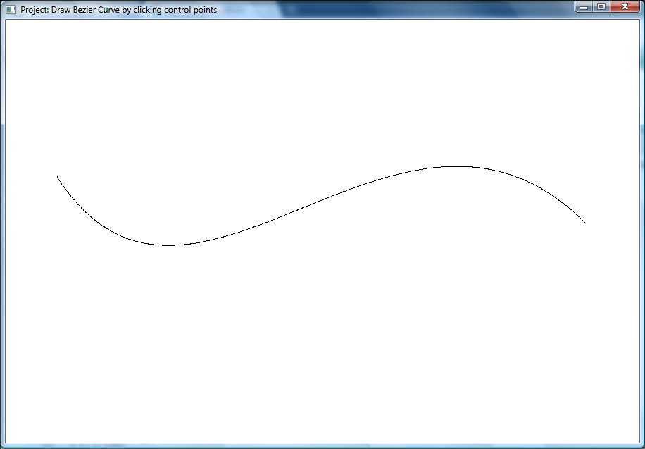
Cubic Curves
Original curve consists of 828 points
Overlaid cubic curve only needs 4 points
Less storage space needed = faster processing time
Bezier Curve Program with Lagrange Interpolation made by Prof. Richard Simpson

Slide 6
Recap
Goal: To write a program to locate and identify the bends in the puzzle pieces
The bends and corners can then be used as the two end points and two control points for the cubic curves

Slide 7

Example – 7 cubics

Slide 8

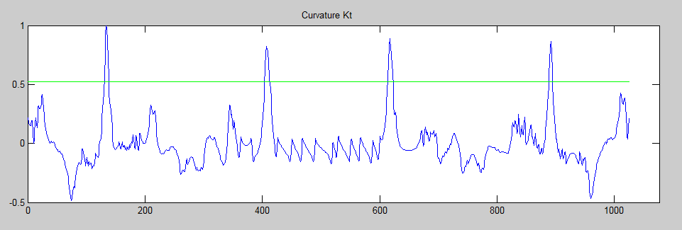
Jacob Staples’ & Dr. Hood’s code
Dr. Hood’s UGROW 2008 research student
Wrote a program to find the corners of the puzzle pieces
Focused on the parameters defining the cut-off line

Slide 9
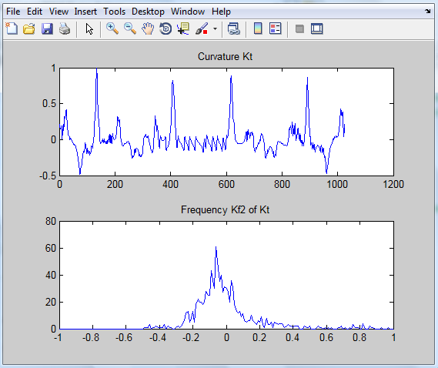
Frequency

Slide 10
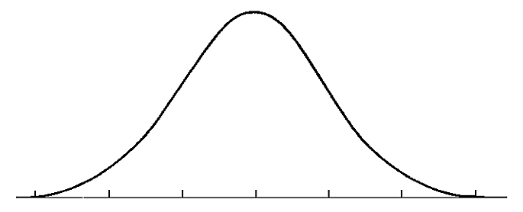
Standard Deviation and Mean
Showed similarities to a bell curve
Bell curve = 68.2% within 1 standard deviation
95.4% within 2 standard deviations
99.6% within 3 standard deviations
Does our data fall into one of these categories?
If not, where do we set our own cut-off line?

Slide 11
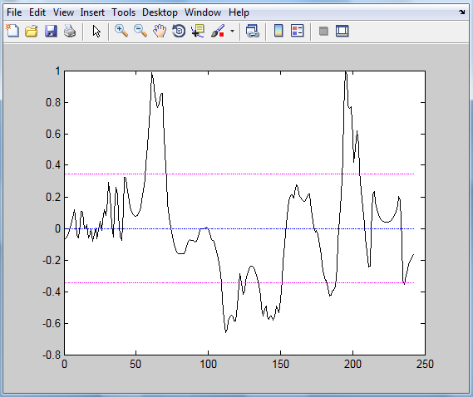
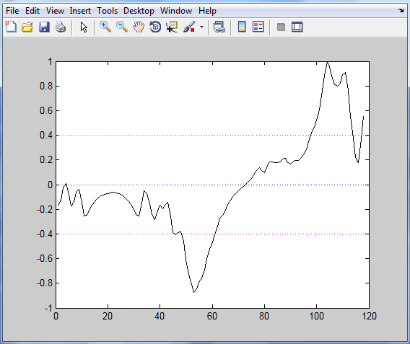
Standard Deviation and Mean cont.
Applied 1 standard deviation from the mean to Kt graph
Missing important bends
Applied 1 standard deviation from the mean to sections of the Kt graph
Was more successful

Slide 12
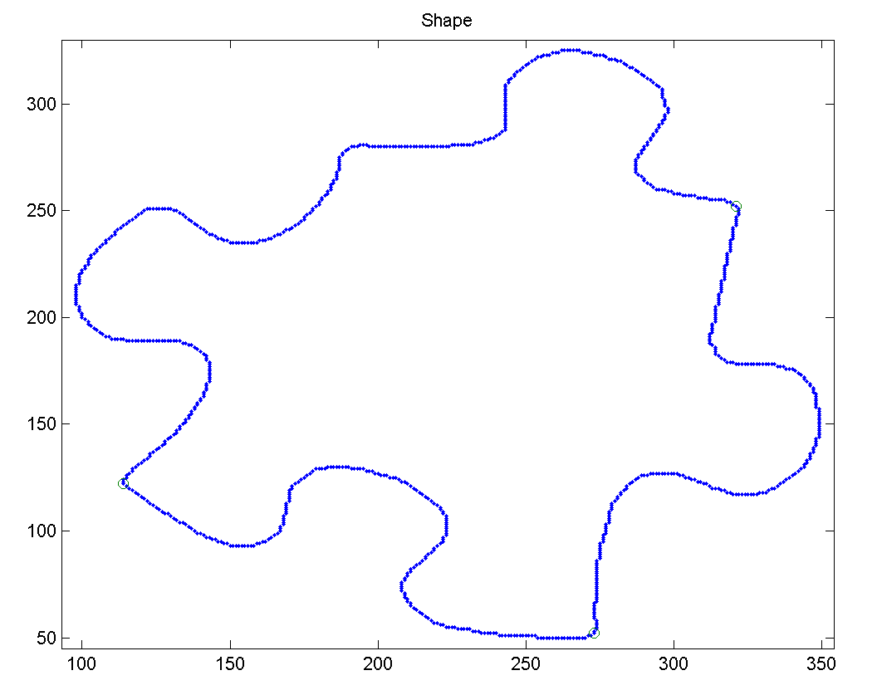
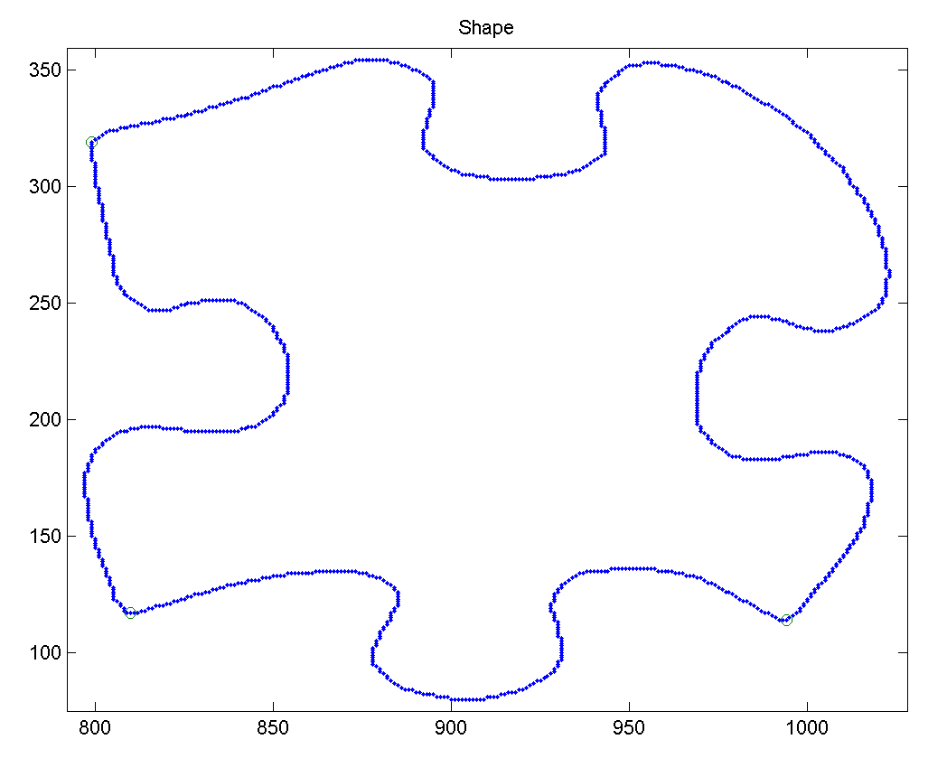
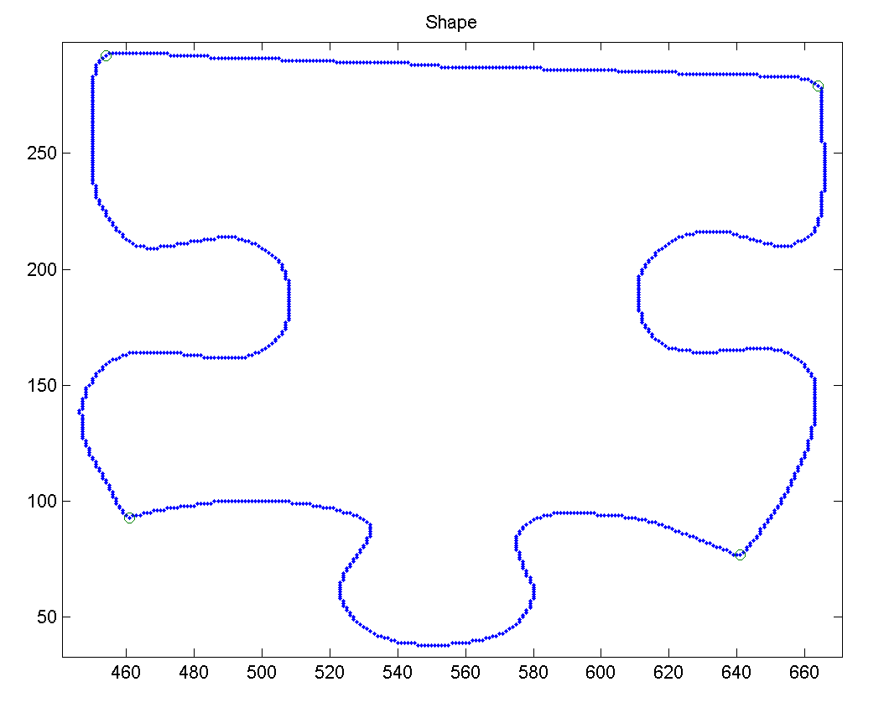
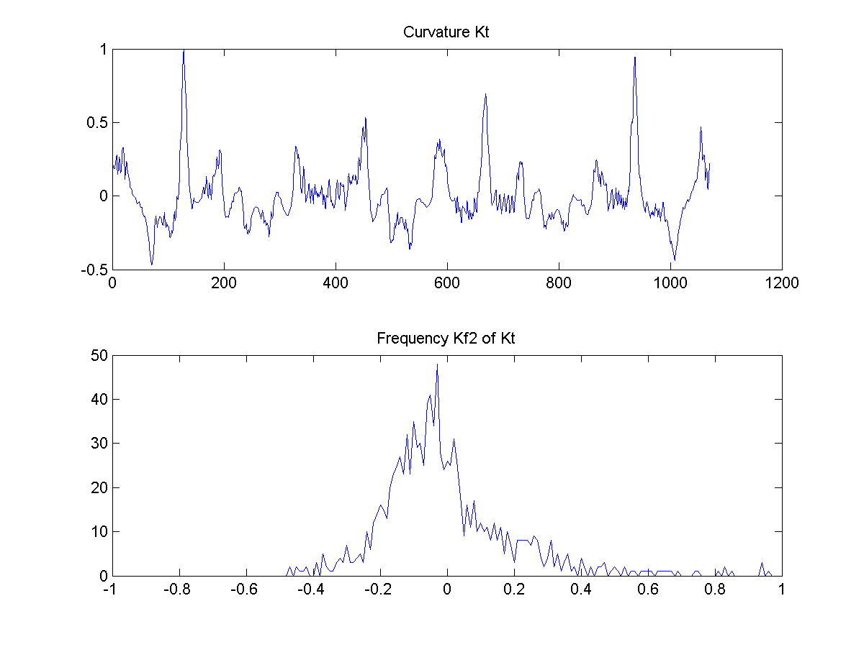
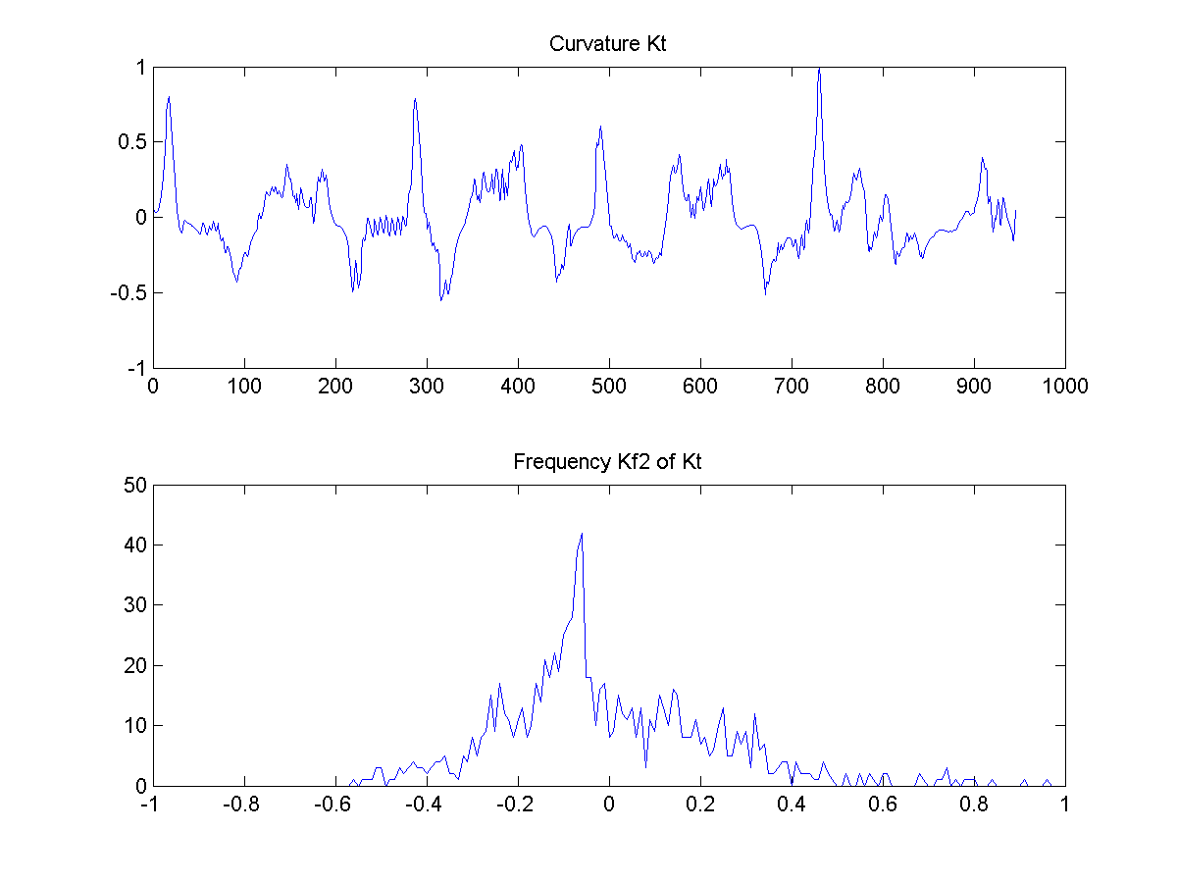
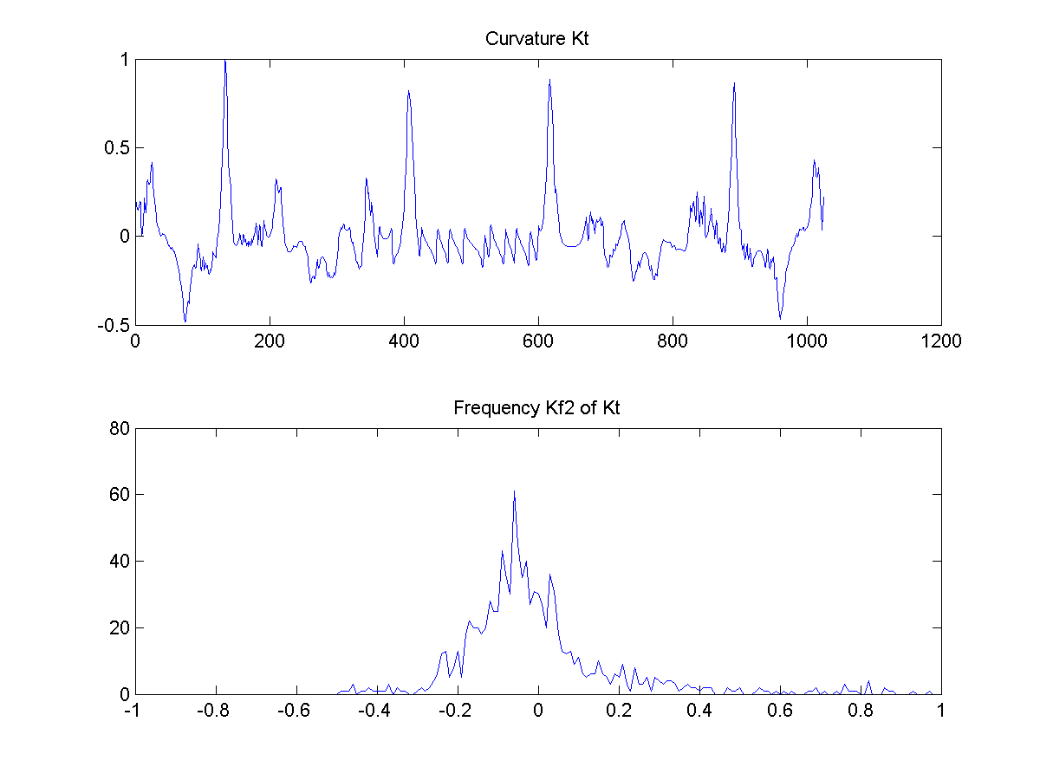
Patterns

Slide 13
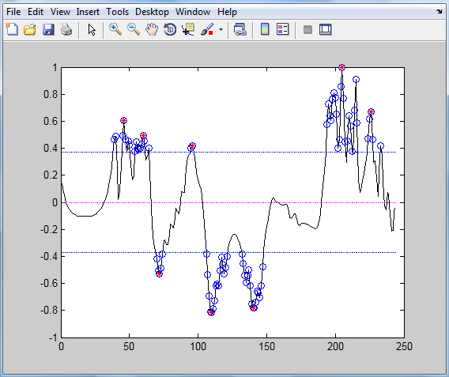
Example – inward bend
EXTRA

Slide 14
Now what?
Not all peaks for the patterns are found
Need to find a different method to differentiate between possible bends and true bends
Test closeness between possible bends
Test width of peak by testing possible solutions

Slide 15
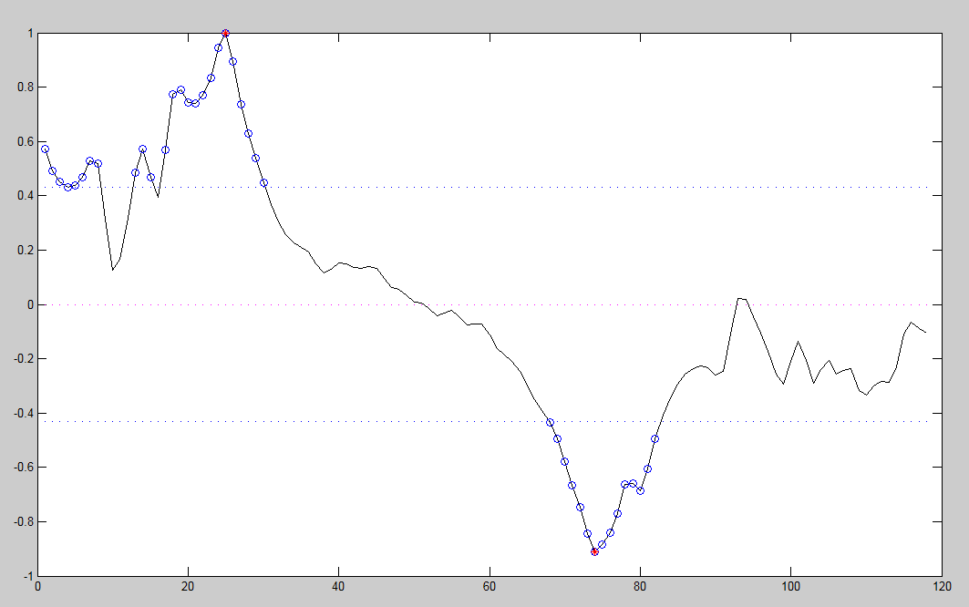
Tolerance

Slide 16
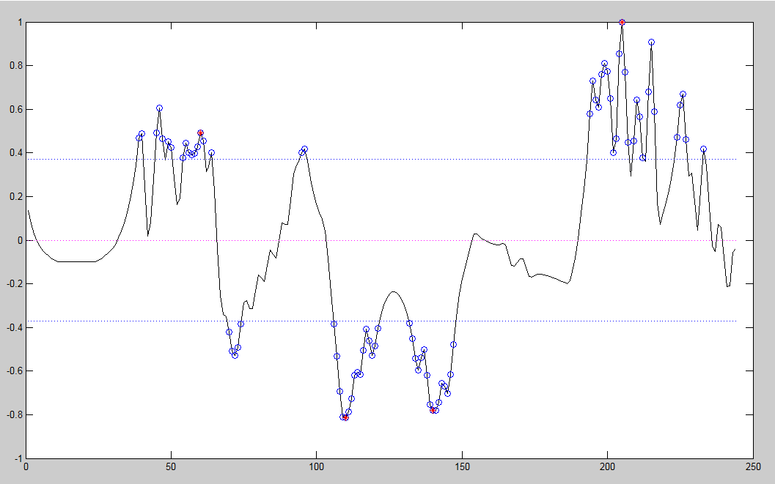
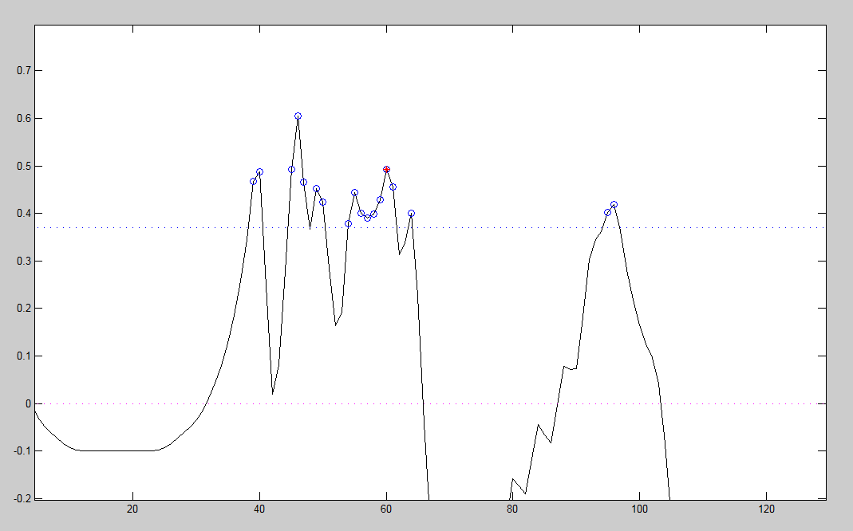
Section width
5
2
8
8
2

Slide 17
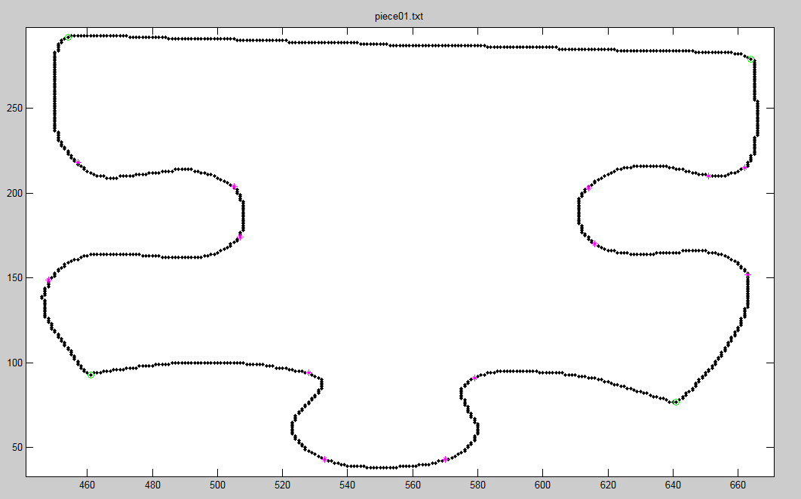
Conclusion
EXTRA

Slide 18
Acknowledgements
UGROW 2010
Dr. Rincón-Zachary
Dr. Rogers
Dr. Farris & the Honors Program
Dr. Hood
Prof. Simpson
Other faculty that were involved in UGROW 2010

Slide 19
Questions?
Thank You for your time

